Slide 1

Micro Service Architecture Introduction
Suresh Selvaraj

Slide 2
Monolithic Drawbacks

Slide 3
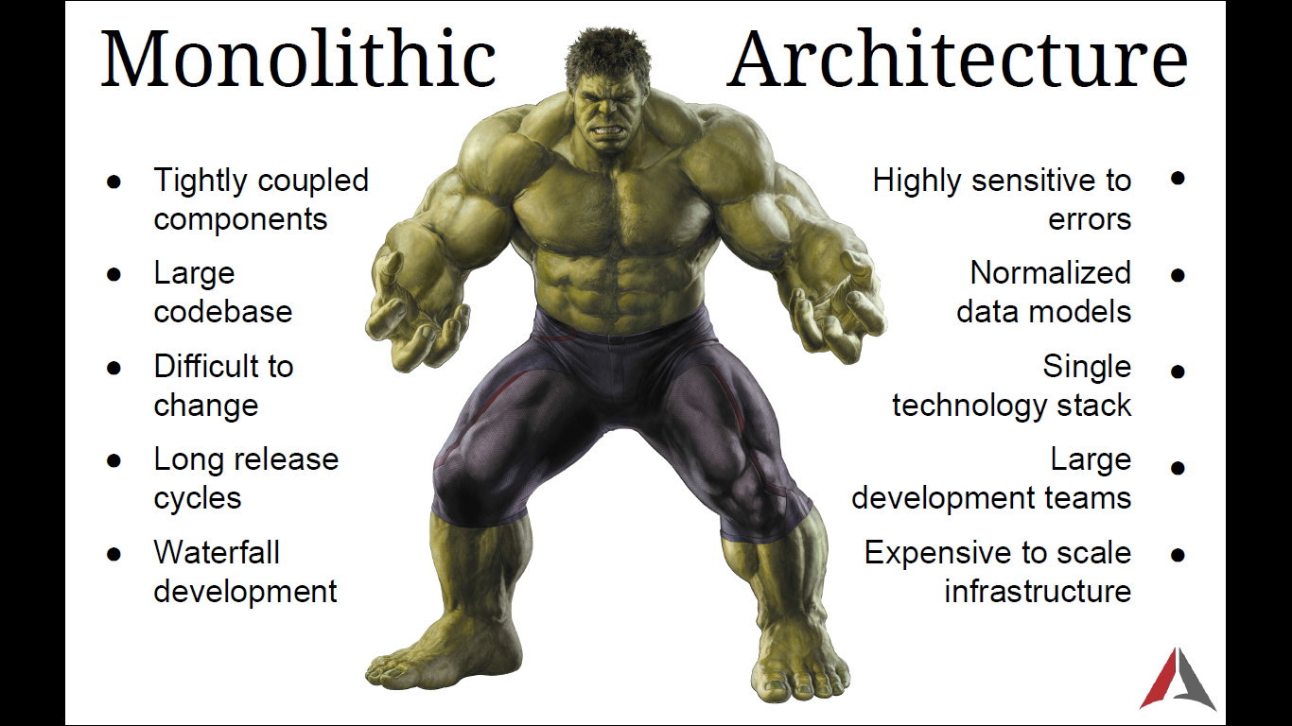

Slide 4

Large Codebase
difficult to understand and modify
– Quality declines over time
– Development slows down

Slide 5
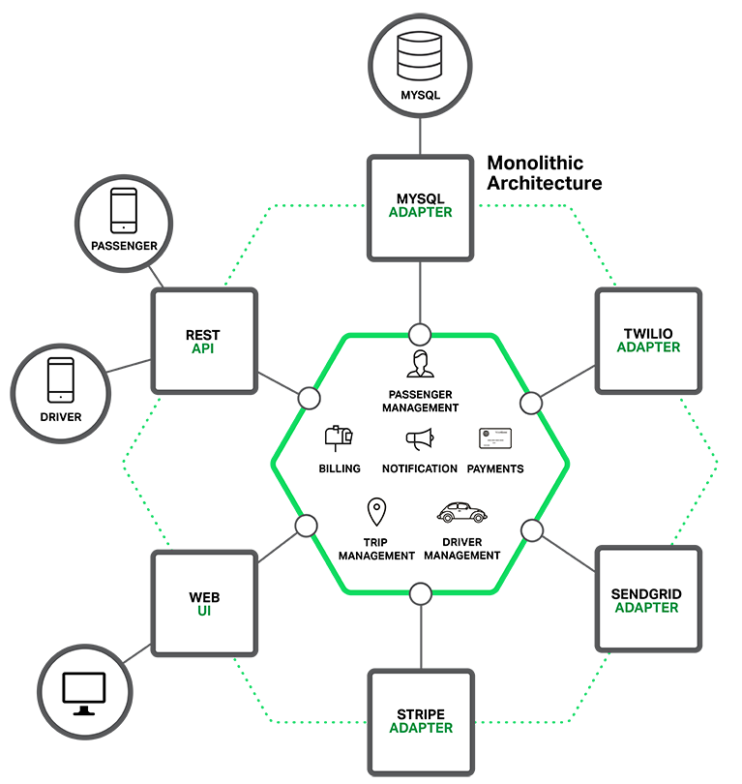
No Module Boundaries
– No bounded context;
- Modularity breaks down

Slide 6


– slower startup
Overloaded Web Container
Overloaded IDE

Slide 7

– slower startup
Overloaded IDE
Overloaded IDE

Slide 8

Difficult Continuous Deployment
Need to redeploy entire application

Slide 9
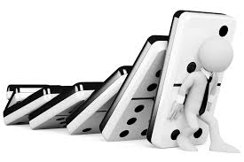
No Fault Isolation
One component fails, entire application fails

Slide 10

Scalability Issue
CPU vs Memory Intensive application deployment

Slide 11

Obstacle to Scaling development
Prevents the teams from working independently

Slide 12

Requires a long-term commitment to a technology stack

Slide 13
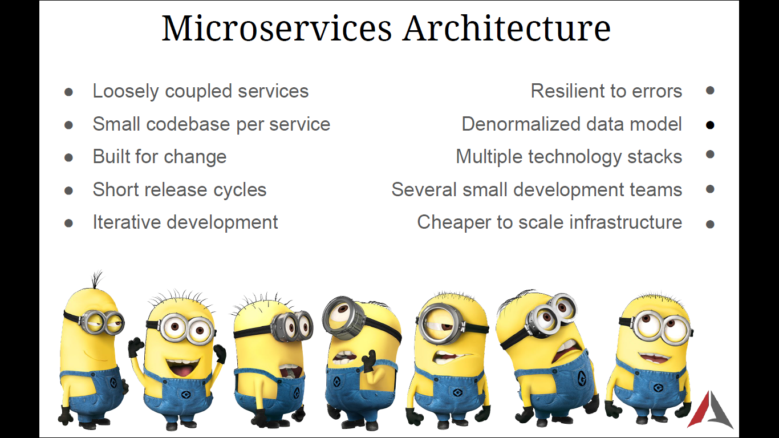

Slide 14

Large Codebase difficult to understand and modify
– Quality declines over time
– Development slows down
Small Codebase easy to understand and modify
– Quality not decline over time
– Development speed up

Slide 15
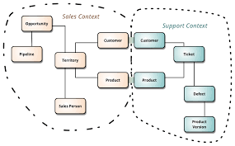
No Module Boundaries
– No bounded context; Modularity breaks down
Domain Driven Design
– bounded context; Modularity maintained

Slide 16
– slower startup
Overloaded Web Container
Overloaded IDE

Slide 17
– slower startup
Overloaded IDE
Overloaded IDE

Slide 18
Difficult Continuous Deployment
Need to redeploy entire application

Slide 19
No Fault Isolation
One component fails, entire application fails

Slide 20
Scalability Issue
CPU vs Memory Intensive application deployment

Slide 21
Obstacle to Scaling development
Prevents the teams from working independently

Slide 22
Requires a long-term commitment to a technology stack

Slide 23
SUMMARY
Scalability Issue - both development and deployment
No Bounded Context
Large code base
Tight coupling with technology

Slide 24


Addressing scalability issue

Slide 25
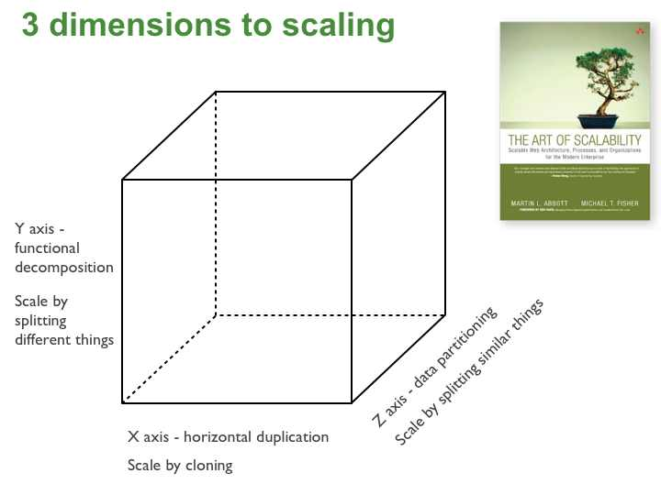
Microservices is more about the
Functional Decomposition

Slide 26
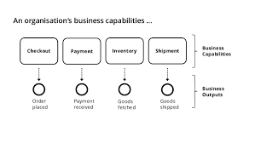
Microservices is more about the
Business Capabilities

Slide 27
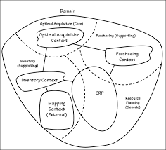
Bounded Context
Microservices tackles complexity through the modularity
Service boundaries enforce modularity

Slide 28

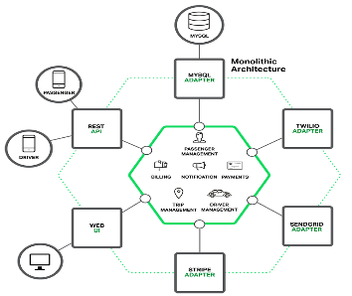

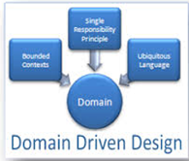
Scalability
3 Dimensional Scaling
Functional Decomposition
Bounded Context
Modularity
Bounded Context
Business Capability
Large Codebase

Slide 29
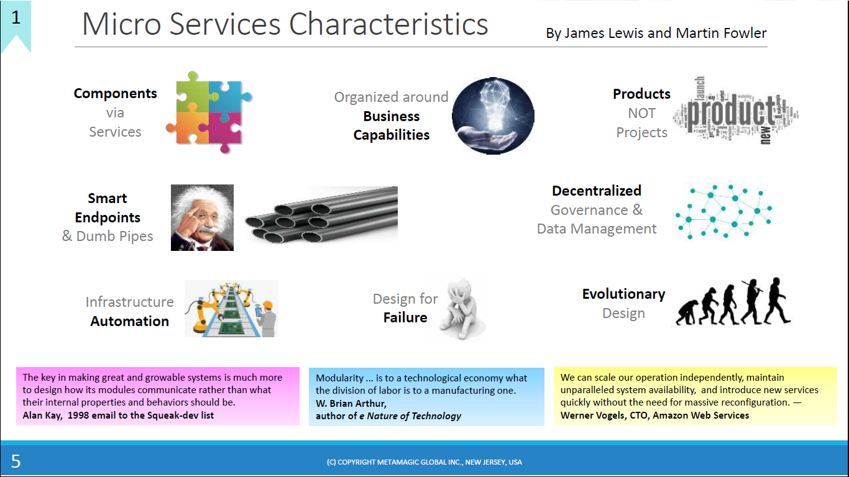

Slide 30
What?
The term "Microservice Architecture" has sprung up over the last few years to describe a particular way of designing software applications as suites of independently deployable services. While there is no precise definition of this architectural style, there are certain common characteristics around organization around business capability, automated deployment, intelligence in the endpoints, and decentralized control of languages and data
~ Martin Fowler
architectural style
Collection of loosely coupled and collaborating services
Business capabilities
Independently deployable services
Automated deployment
Intelligent endpoints
decentralized control of languages and data

